Slide 1

Optimizing E-Commerce Strategies through RFM Analysis:
A Machine Learning Approach to Classify Customer Segments
Julius Cris Salinas MSDS 2025 PT-A

Slide 2
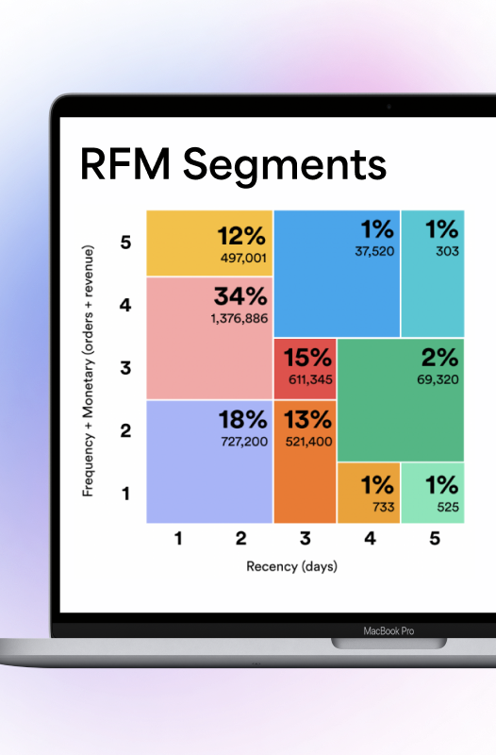
Outline
Problem Statement
What is RFM Analysis?
Methodology Overview
Exploratory Data Analysis
Results
Now What?

Slide 3

Problem Statement
This project aims to optimize e-commerce customer segmentation by combining RFM analysis and machine learning to accurately classify customer segments, thereby optimizing marketing strategies and driving sustainable growth

Slide 4
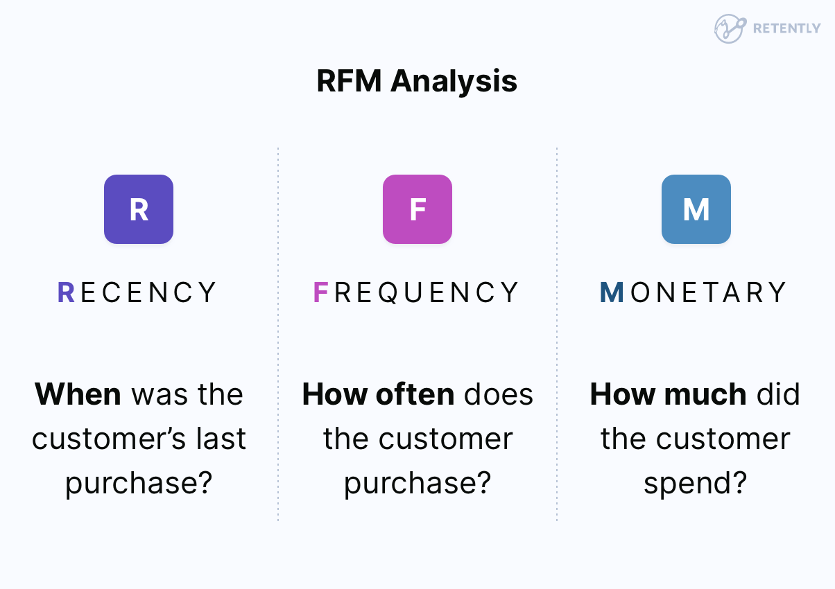
What is RFM Analysis?

Slide 5

What is RFM Analysis?
RFM can help you answer these questions:
Who can you upsell higher-value products to?
Who can you send personalized messages to keep them from churning?
Who is most likely to engage with your brand?
Who can you offer limited-time offers to and try to reactivate?

Slide 6

Methodology Overview
EDA
Outlier Removal
Deriving Target Variable from RFM Analysis
Feature Selection
Standardization
Hyperparameter Tuning
Model Evaluation and Feature Importance

Slide 7
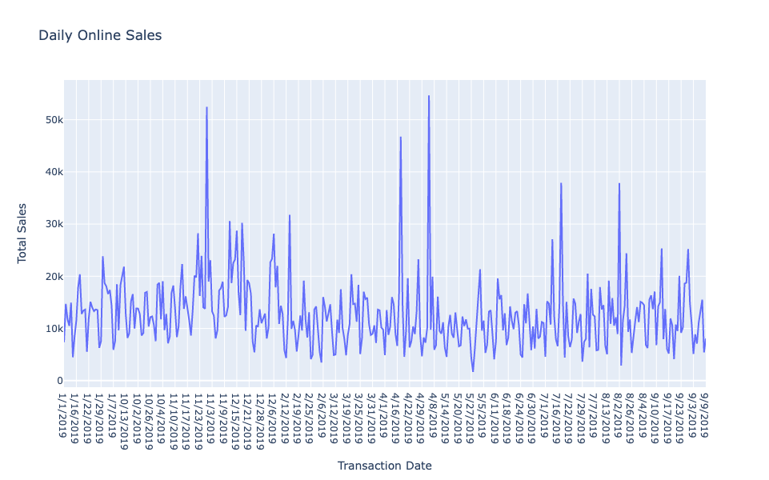
Exploratory Data Analysis
Daily Online Sales

Slide 8
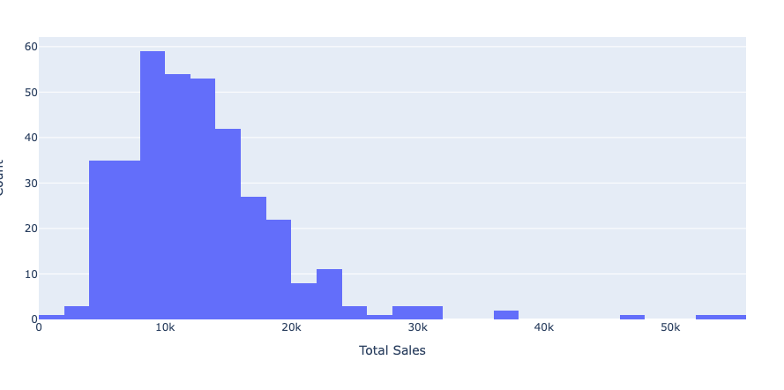
Exploratory Data Analysis
Histogram of Total Sales

Slide 9
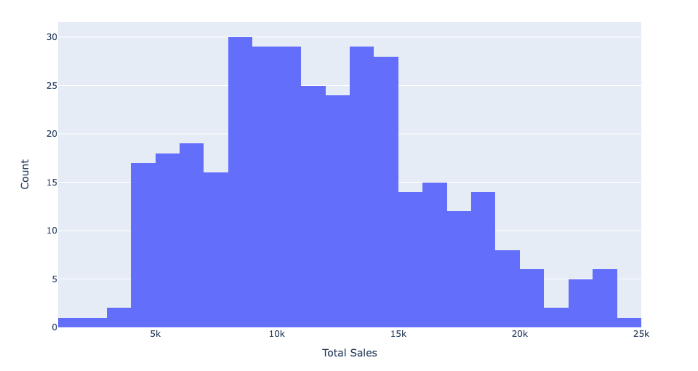
Outlier Removal
Histogram of Total Sales

Slide 10
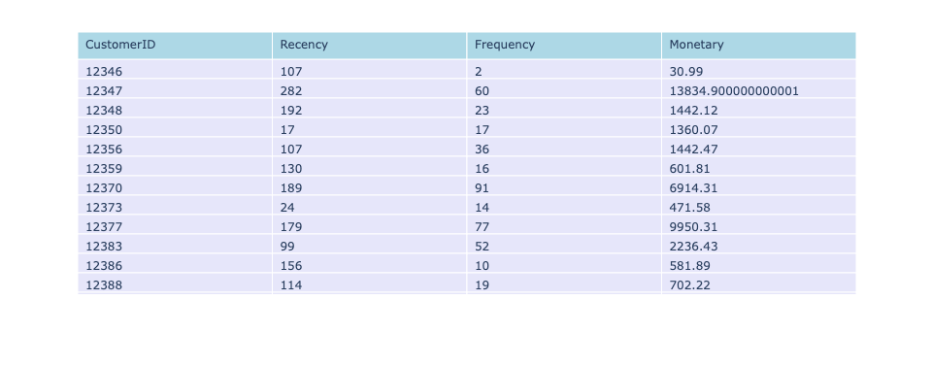
Deriving Target Variable (Customer Segment)
RFM Data for Customers

Slide 11
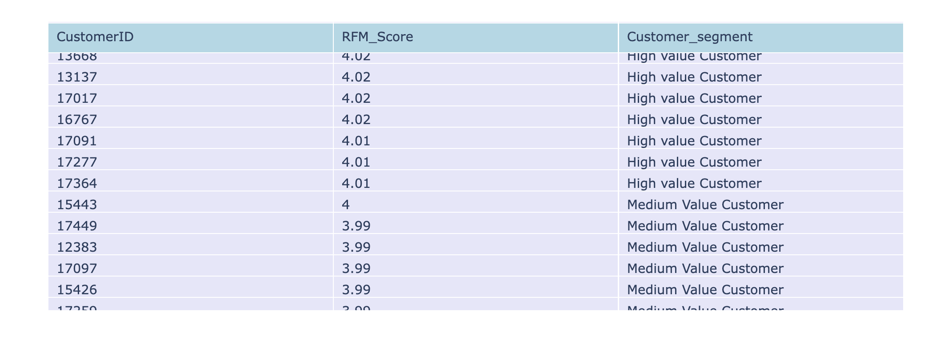
Deriving Target Variable (Customer Segment)
Customer Segment Based on RFM Score

Slide 12
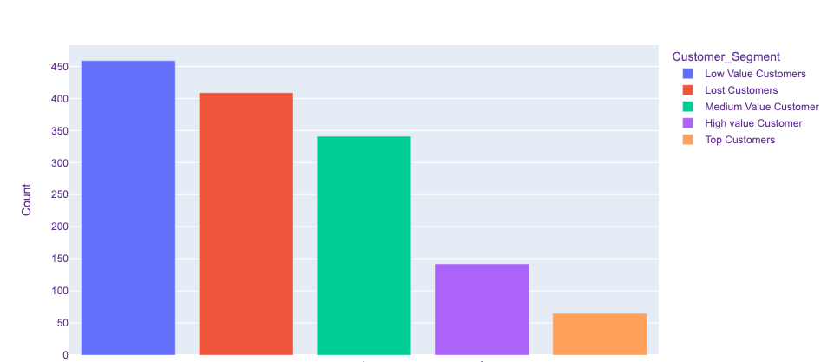
Deriving Target Variable (Customer Segment)
Distribution of Customer Segments

Slide 13
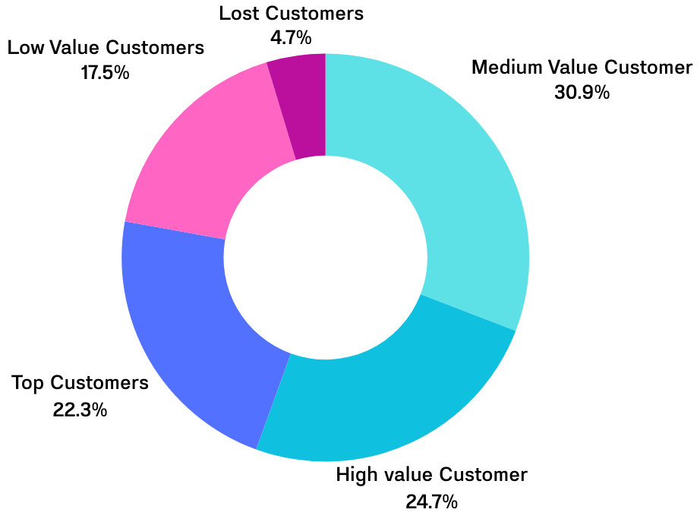
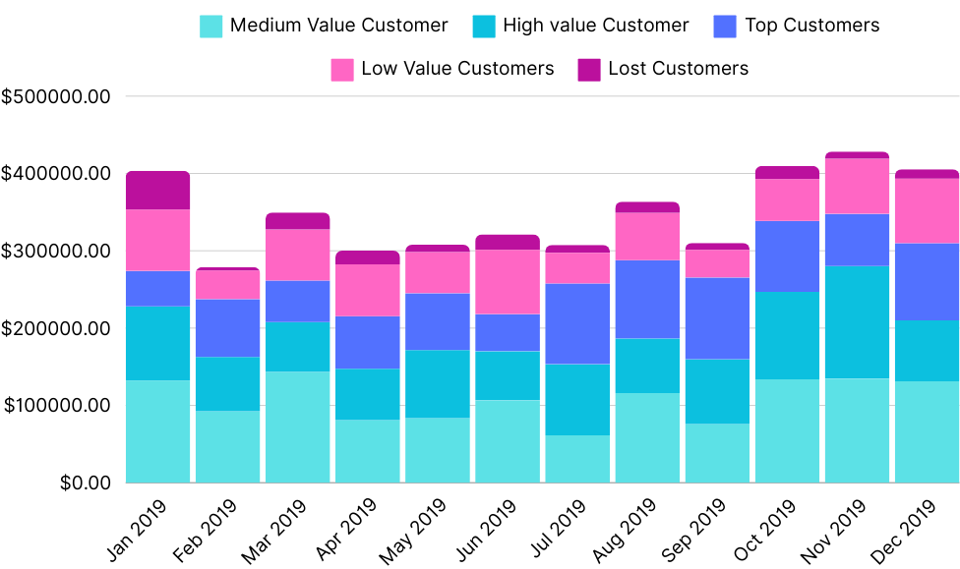
Exploratory Data Analysis
2019 Monthly Total Sales by Customer Segment

Slide 14
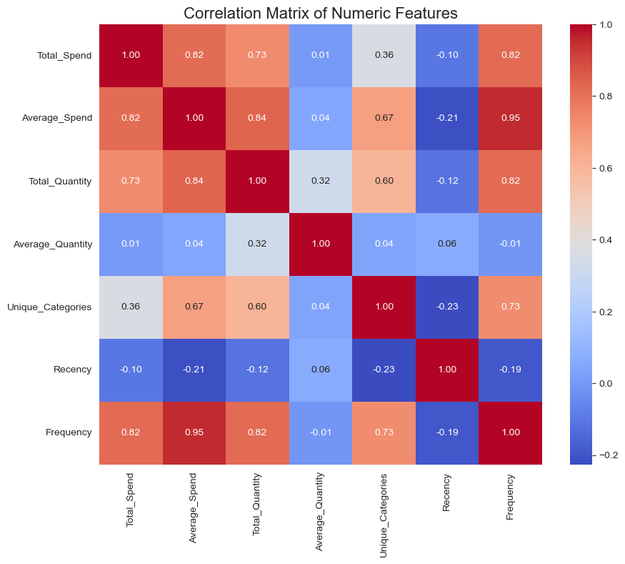
Feature Selection
Only Numeric Features were retained to simplify the model.
Average_Spend has a high correlation with Frequency

Slide 15
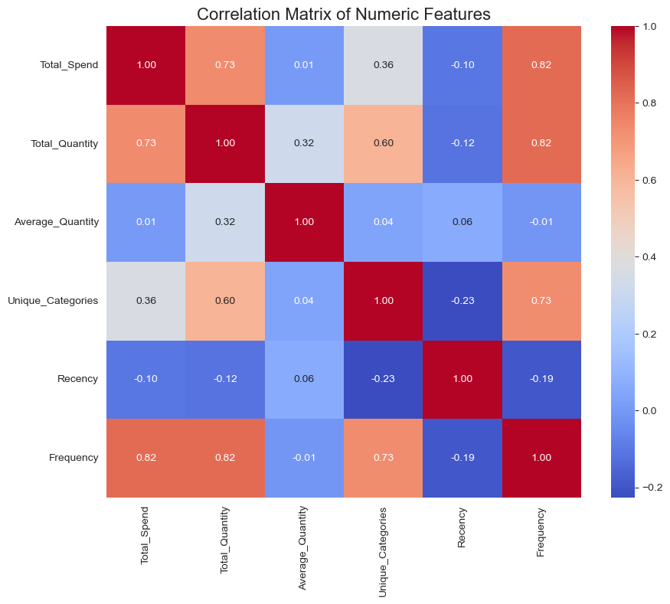
Feature Selection

Slide 16
WHICH FEATURE DO YOU THINK WOULD BE THE MOST IMPORTANT?
Recency?
Frequency?
Monetary?

Slide 17
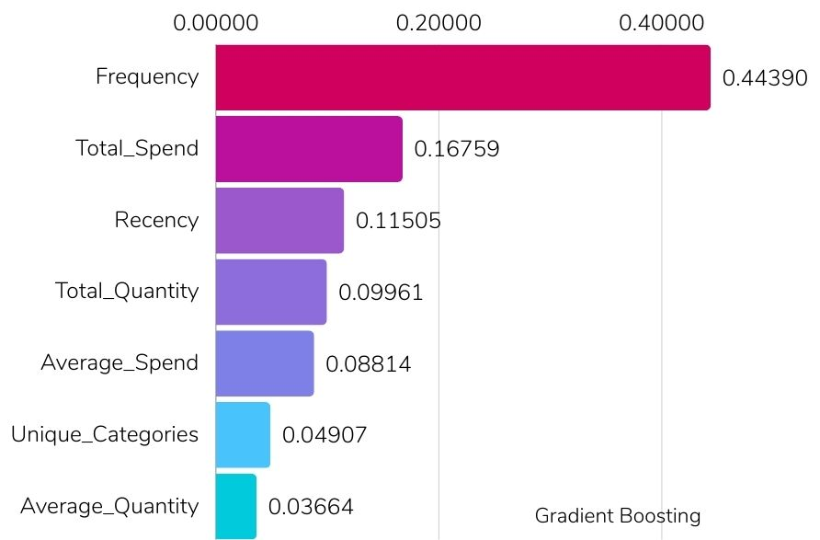
Feature Importance For Gradient Boosting Method

Slide 18
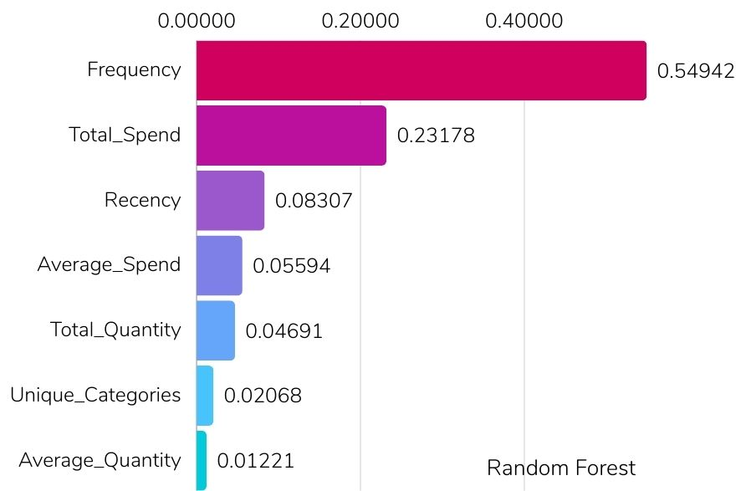
Feature Importance for Random Forest

Slide 19
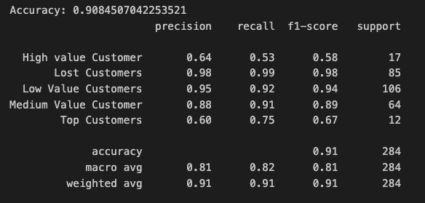
Model Evaluation

Slide 20
Model Evaluation

Slide 21

What to do with this?
Personalized Communication:
Targeted Advertising
Product Development and Innovation:
Customer Loyalty and Retention:
Cross-Selling and Up-Selling Opportunities

Slide 22
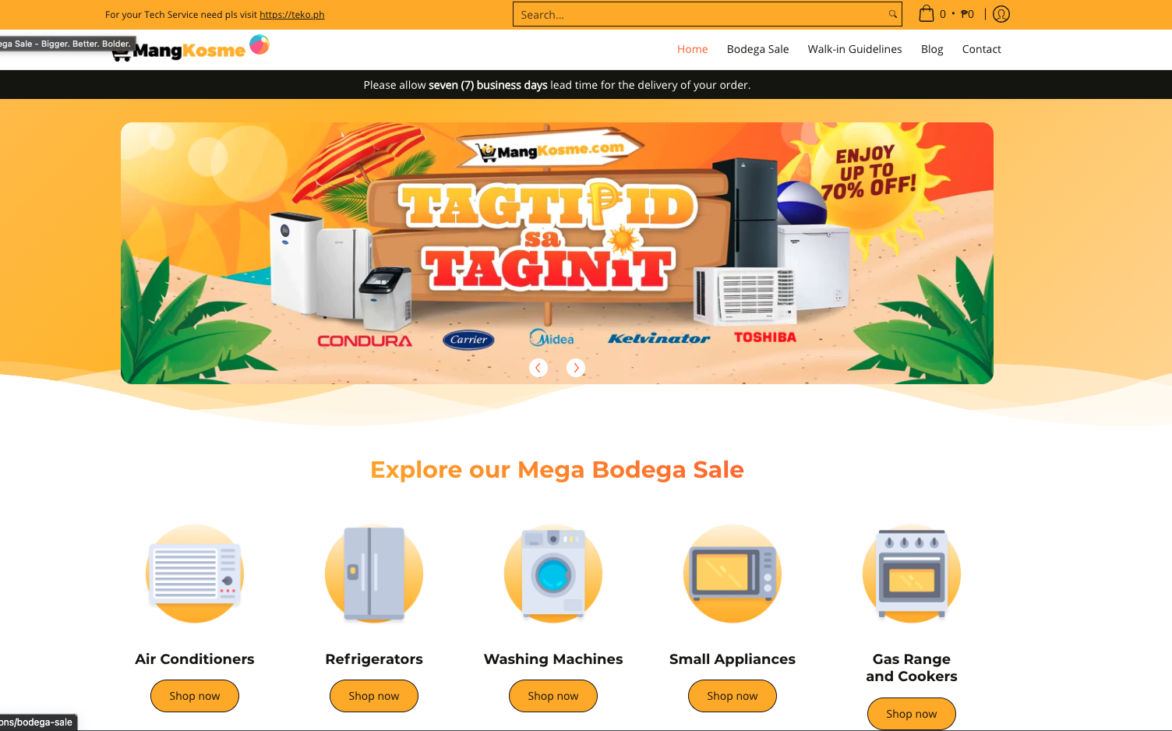

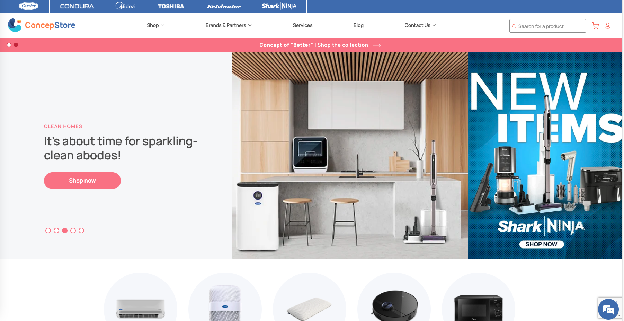

Now What?
One of my goals is to fully integrate this model to our company’s ecommerce stores mangkosme.com and concepstore.com

Slide 23
Thank you!

